Slide 1
Ensuring Robust Fisheries Improvement Plans
Richard Banks
15 April 2014

Slide 2
Acknowledgements
WWF US and all the WWF national fishery officers and support teams that have supported the implementation of the programmes. These include fisheries in Indonesia, Philippines, Vietnam and Thailand

Slide 3
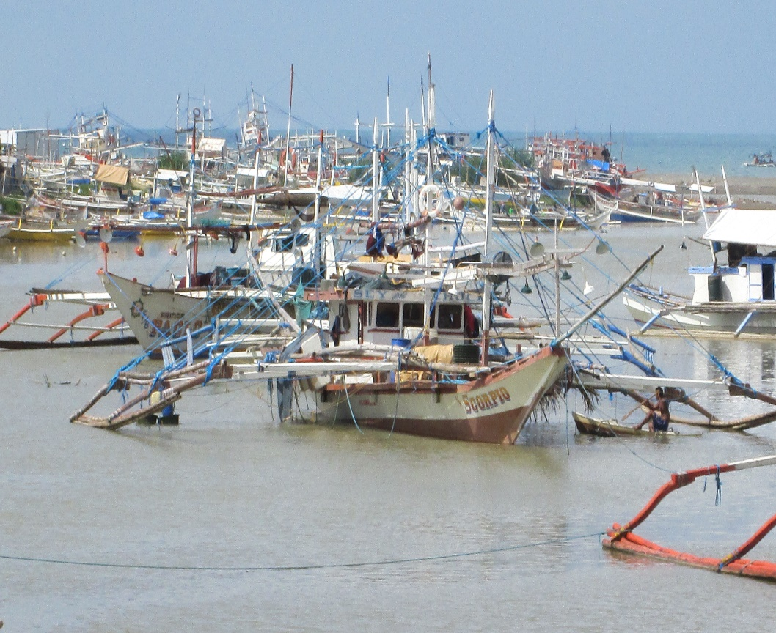
Ensuring Robust Fisheries Improvement Plans
SEVEN steps involved in FIP projects
Pre-assessment fishery
Scoping
Workshop
The Logframe
FIP Implementation
Monitoring and evaluation
FIP Review and benchmark tracking tool
Solomon Islands receives maximum economic and social benefits from sustainable use of tuna resources

Slide 4
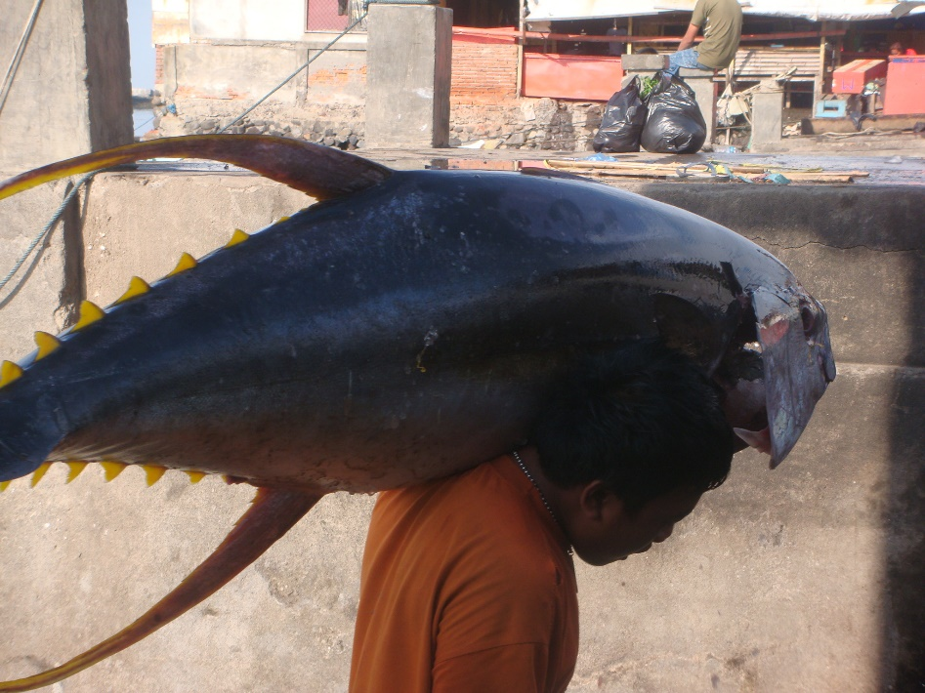
Ensuring Robust Fisheries Improvement Plans
1. Pre-assessment fishery
Unit of Certification – fleet, stock, gear, bycatch, international, national and local governance issues
Sufficiently detailed to identify weaknesses in each scoring guidance DON’T FLINCH ON TIME / BUDGET!
Solomon Islands receives maximum economic and social benefits from sustainable use of tuna resources

Slide 5
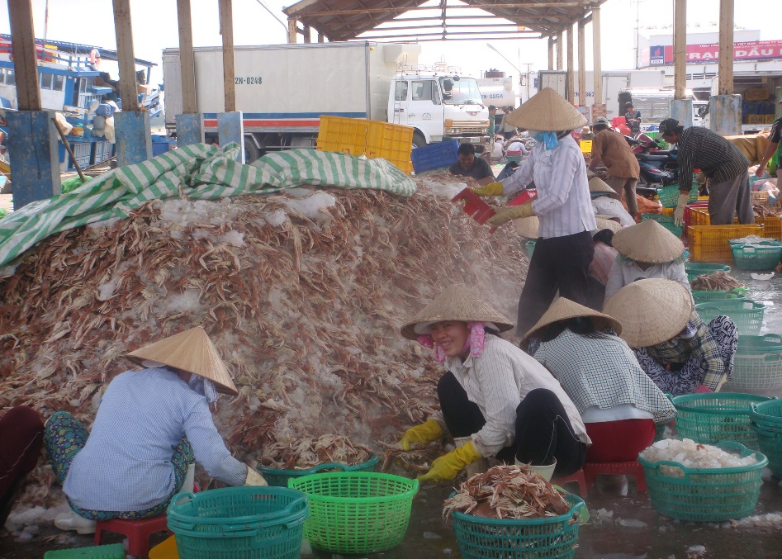
Ensuring Robust Fisheries Improvement Plans
2. Scoping
Identification by assessor of necessary actions based on weaknesses and best practice
Formulate these into outcomes, activities and milestones
SAME PRE ASSESSMENT ASSESSOR AND FIP DESIGNER
KNOWLEDGE OF THE FISHERIES IS A SIGNIFICANT ADVANTAGE
PROGRAMME PLANNING SKILLS
Solomon Islands receives maximum economic and social benefits from sustainable use of tuna resources

Slide 6
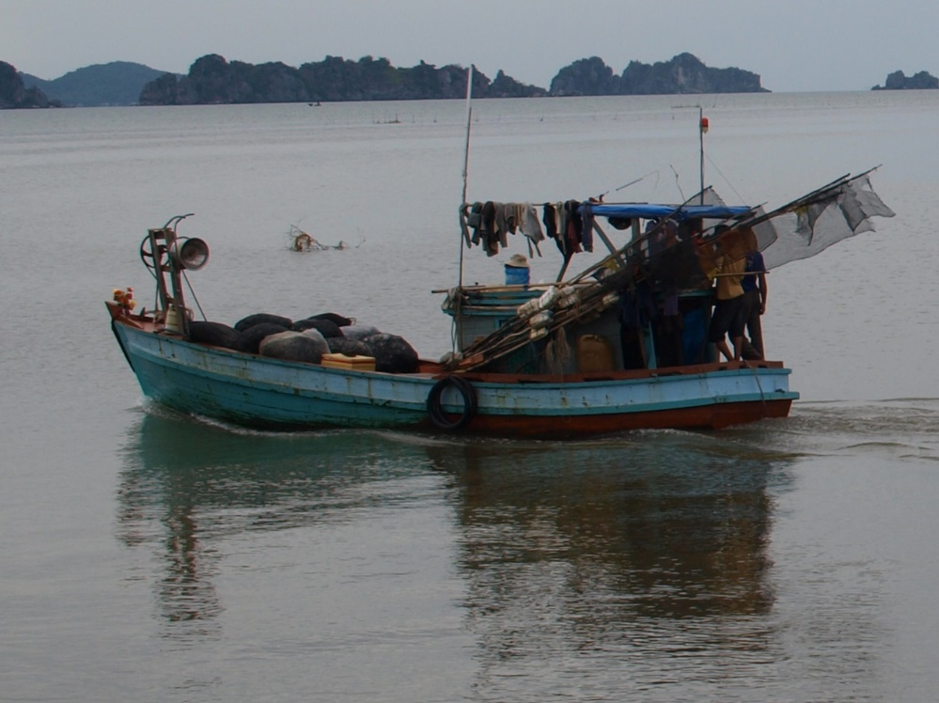
Ensuring Robust Fisheries Improvement Plans
3. Workshop
Revisit pre-assessment outcomes to test the results
Illustrate how the scoring guidance works – good and bad examples
Discuss each of the goals, outcomes, activities and milestones and agree corrective actions
Identify implementation partners
Identify timelines
Identify constraints
Identify Means of Verification
STRONG PRE PREPARATION WITH KEY STAKEHOLDERS
GOVERNMENT & RESEARCH PARTCIPATION CRITICAL
1-2 DAY PROCESS
KEEP ACTIVITIES AND MILESTONES SIMPLE BUT CONSISTENT WITH THE SGs
Solomon Islands receives maximum economic and social benefits from sustainable use of tuna resources

Slide 7
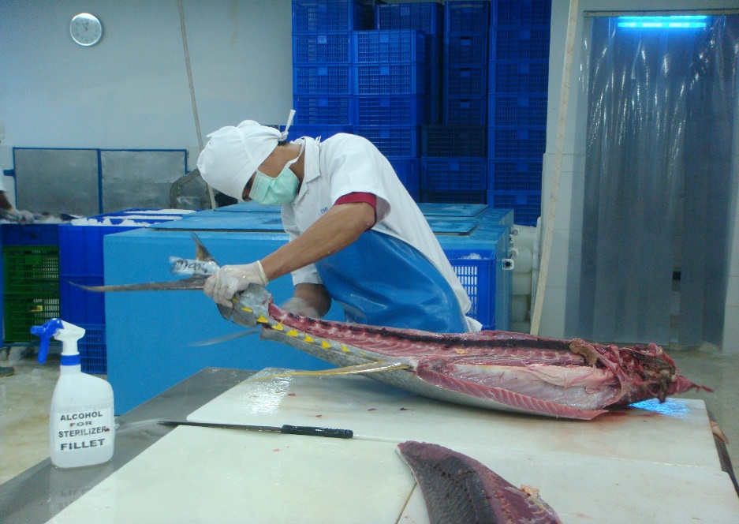
Ensuring Robust Fisheries Improvement Plans
Examples of goals and outcomes
Goals
Stock status and fisheries management: To ensure that the tuna catches do not exceed sustainable levels
Ecosystem management: To promote the ecosystem based approach to fisheries management
Governance systems: To strengthen governance systems in the Indonesia’s’ Tuna fishery
Outcomes:
Stock status improved and reference points applied in management
Tuna management strategies applied
Data collection and information systems strengthened
Tuna research plan in place
Retained species subject to a management strategy
Legal framework implemented
Fishery specific management objectives applied
Effective application of compliance systems
GOALS AND OUTCOMES ARE CONSISTENT WITH GOOD FISHERIES MANAGEMENT PLANNING
Solomon Islands receives maximum economic and social benefits from sustainable use of tuna resources

Slide 8
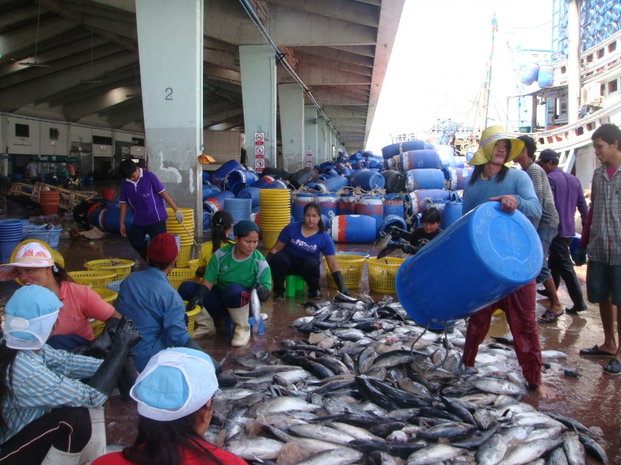
Ensuring Robust Fisheries Improvement Plans
Examples of activities
Outcome 1 Stock status improved and reference points applied in management
Activity 1.1: Support training in stock assessment modelling for senior scientist and graduates
Activity 1.2: Regional and national reference points adopted and formulated into harvest strategy
Outcome 2: Tuna management strategies applied
Activity 2.1: Harvest strategy incorporates LRPs (as above) and is responsive to the state of the stocks
Activity 2.2: Harvest tools adopted
Outcome 3: Data collection and Information systems strengthened
Activity 3.1: Comprehensive catch data are collected in standard format.
Activity 3.2: Port sampling programmes covering growth parameters and trophic issues undertaken will provide data on, and will be established in the major tuna fishery ports.
Activity 3.3: Observer programme consistent with RFMO requirements
Activity 3.4: Integrated vessel data base covering District, Provincial and National Fishing vessels
Solomon Islands receives maximum economic and social benefits from sustainable use of tuna resources

Slide 9
Activity 1.2: Regional and national reference points adopted and formulated into harvest strategy
Milestone 5: Explicit LRPs finalized at WCPFC for skipjack, yellowfin and bigeye tuna – (WCPFC, Q3 2013) – Limit Reference Points have been set at WCPFC at set at 20%SB _{recent, F=0.} (WCPFC 10) for skipjack, yellowfin and bigeye tuna.
Milestone 6: Explicit TRPs finalized at WCPFC for skipjack, yellowfin and bigeye tuna – (WCPFC, Q4 2014) – Likely to be achieved by the end of 2014.
Milestone 7: Explicit LRPs and TRPs set at IOTC for skipjack, yellowfin and bigeye tuna (IOTC, Q4 2015)- The milestone can only be achieved once fully integrated with IOTC strategy.
Milestone 8: Indonesia incorporates these Reference Points into the national tuna management strategy, including in waters under its sovereignty (MMAF, Q4 2015).

Slide 10
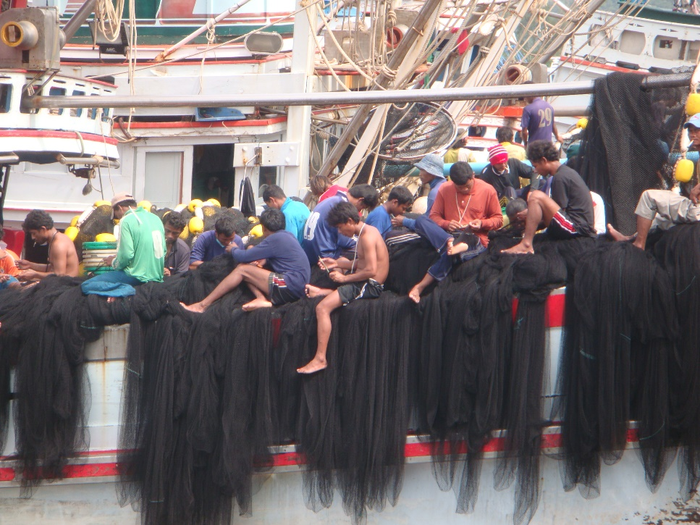
Ensuring Robust Fisheries Improvement Plans
4. Logframe planning
Refining activities and milestones so that they are consistent with the MSC scoring guideposts
Confirming stakeholders and preparing Terms of Reference consistent with the activities, milestones and scoring guidance
Defining means of verification, including literature research
Solomon Islands receives maximum economic and social benefits from sustainable use of tuna resources

Slide 11
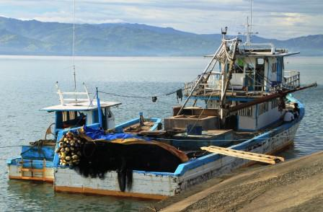
Ensuring Robust Fisheries Improvement Plans
5. FIP implementation
Good programme manager
Strong engagement of stakeholders, but critical to have Government onboard
Funding streams
Strong M&E process
Solomon Islands receives maximum economic and social benefits from sustainable use of tuna resources

Slide 12
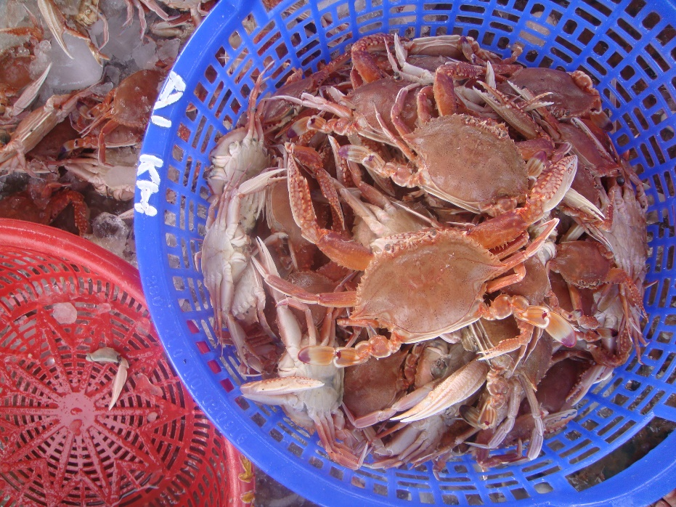
Ensuring Robust Fisheries Improvement Plans
6. Monitoring and evaluation
Strong emphasis on project design
Distance monitoring by using MoVs and dropbox
Good communication skills of the project manager
Bi-annual reviews (at least in the early stages)
DON’T MAKE IT TOO COMPLICATED – EG FIP TRACKING DOCUMENT!!! DEFINITELY NOT DESIGNED BY PROGRAMME PLANNERS
Solomon Islands receives maximum economic and social benefits from sustainable use of tuna resources

Slide 13
Ensuring Robust Fisheries Improvement Plans
7. FIP Review and BMT
Review of activities and milestones achieved with project manager and selected stakeholder experts
Workshop review process to agree amended activities and timelines
Review of FIP Document, Logframe, budget and TORs
BMT compliance
BMT IS MEANINGLESS WITHOUT STRONG PROJECT DESIGN FRAMEWORK
Solomon Islands receives maximum economic and social benefits from sustainable use of tuna resources

Slide 14
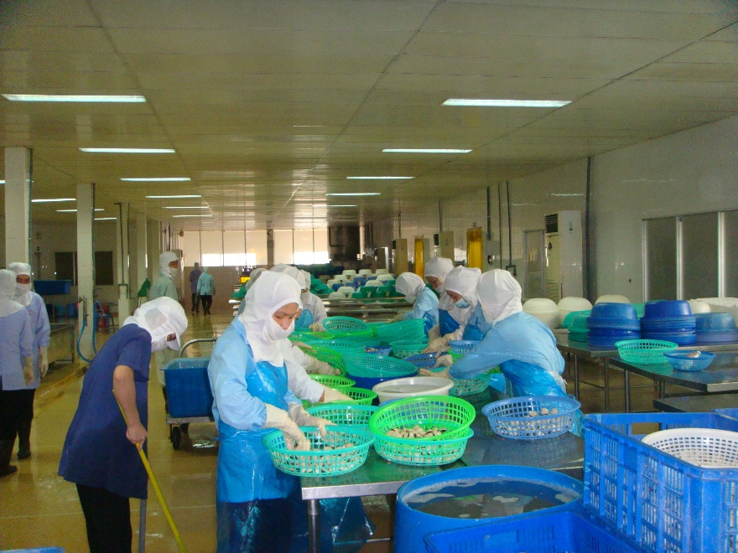
Ensuring Robust Fisheries Improvement Plans
Barriers to successful implementation
Resistance good design framework and NGOs/consultants that know better (reinventing the wheel!)
Political agendas not consistent with FIPs
Resistance to the incorporation of new ideas
Insufficient budgeting
Insufficient human/institutional capacity for implementation
Difficulties in obtaining stakeholder agreement and participation
Barriers can be reduced through (1) Careful attention to design and (2) careful explanation of the benefits of successful implementation
Solomon Islands receives maximum economic and social benefits from sustainable use of tuna resources

Slide 15
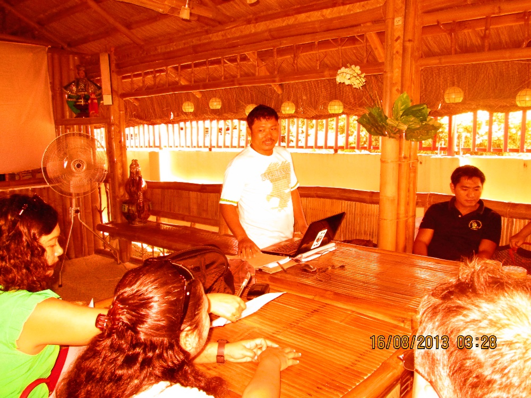
Ensuring Robust Fisheries Improvement Plans
Thank you very much
Terima kasih banyak
Cảm ơn bạn rất nhiều
Salamat sa iyo para sa iyong uri ng pansin
ขอบคุณมาก
Solomon Islands receives maximum economic and social benefits from sustainable use of tuna resources

